Slide 1
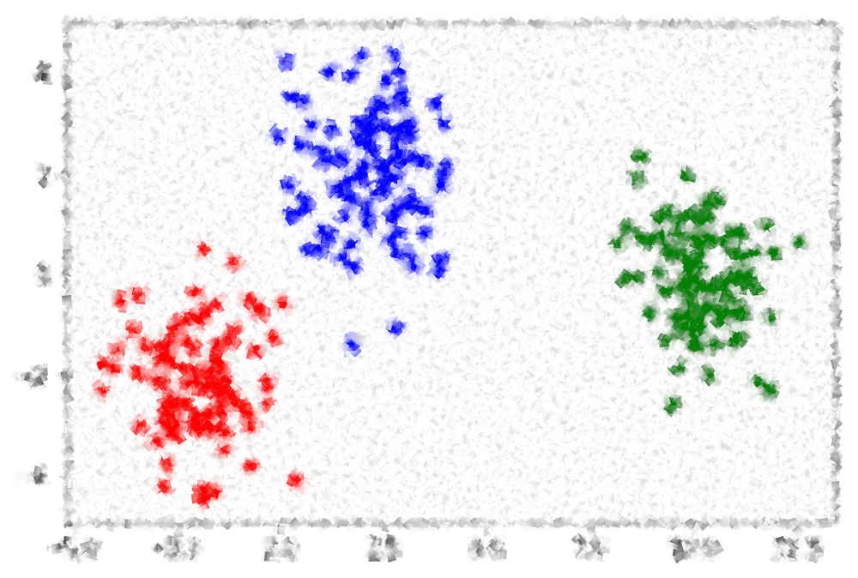
Visualisations
ISYS2001, School of Marketing and Management

Slide 2
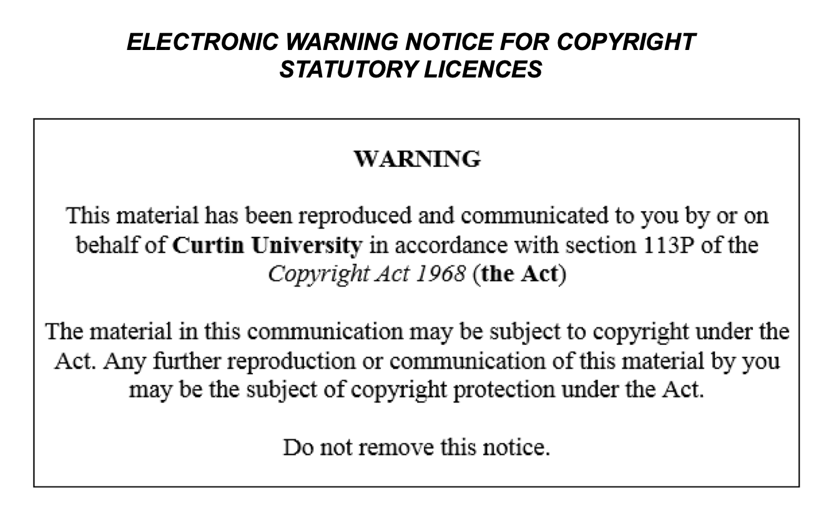

Slide 3
I acknowledge the traditional custodians of the land on which I work and live, and recognise their continuing connection to land, water and community. I pay respect to elders past, present and emerging.

Slide 4
Today
Describe Visualisation
Identify the Common Roles
Use roles to select graph
List common Python plotting packages
Develop a visualisation strategy

Slide 5
Data visualization is the process of translating large data sets and metrics into charts, graphs and other visuals. The resulting visual representation of data makes it easier to identify and share real-time trends, outliers, and new insights about the information represented in the data. (IBM, 2021)

Slide 6
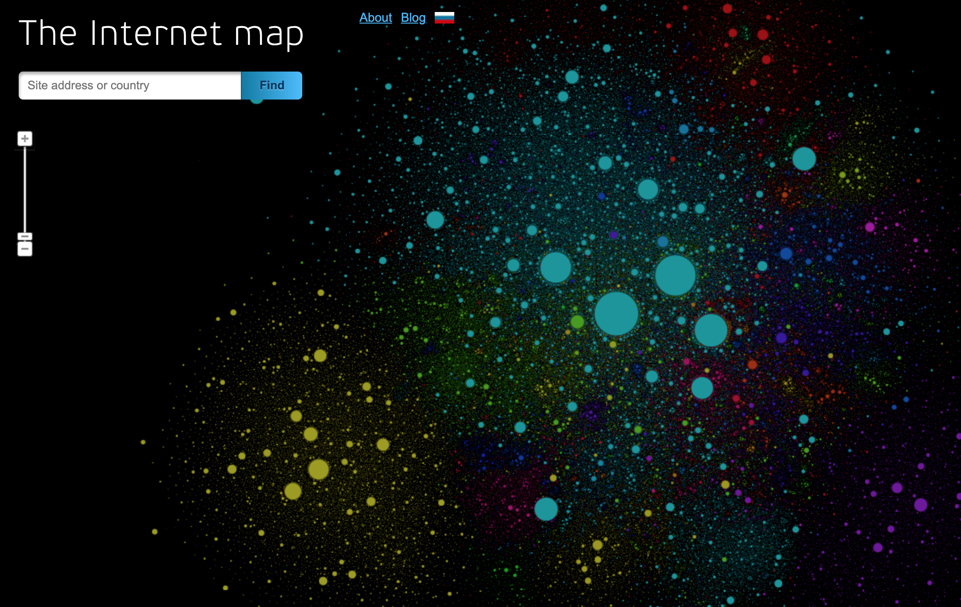
http://internet-map.net/
Notes:
The map of the Internet
Like any other map, The Internet map is a scheme displaying objects’ relative position; but unlike real maps (e.g. the map of the Earth) or virtual maps (e.g. the map of Mordor), the objects shown on it are not aligned on a surface. Mathematically speaking, The Internet map is a bi-dimensional presentation of links between websites on the Internet. Every site is a circle on the map, and its size is determined by website traffic, the larger the amount of traffic, the bigger the circle. Users’ switching between websites forms links, and the stronger the link, the closer the websites tend to arrange themselves to each other.

Slide 7
Common Visualisation Roles
Showing change over time
Showing a part-to-whole composition
Looking at how data is distributed
Comparing values between groups
Observing relationships between variables
Looking at geographical data

Slide 8
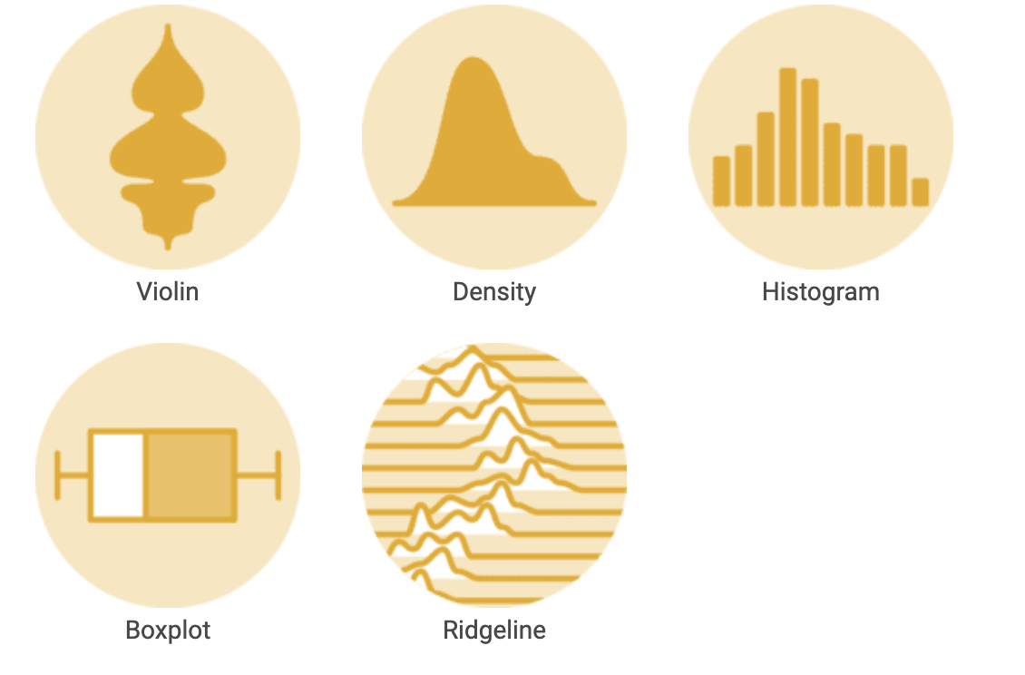
Distribution
https://python-graph-gallery.com/
Notes:
Python Graph Gallery, a collection of hundreds of charts made with Python. Charts are organized in about 40 sections and always come with their associated reproducible code. They are mostly made with Matplotlib and Seaborn but other library like Plotly are sometimes used.

Slide 9
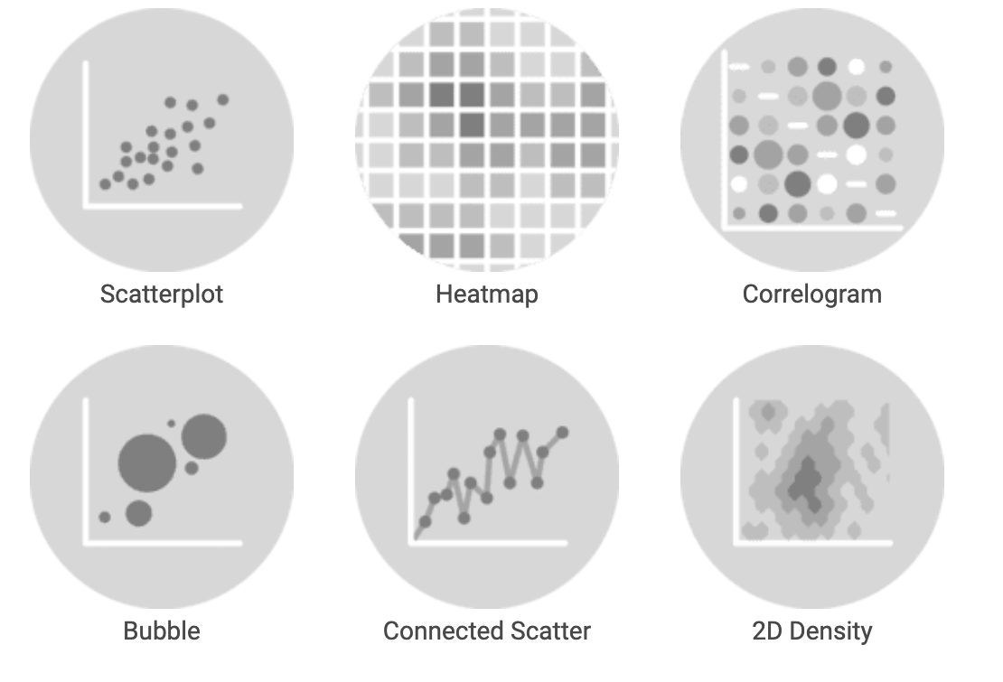
Correlation
https://python-graph-gallery.com/

Slide 10
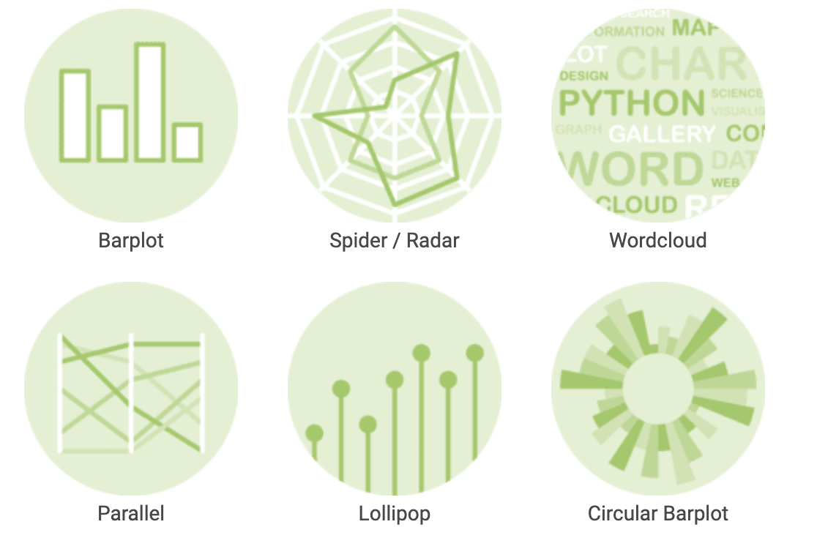
Ranking
https://python-graph-gallery.com/

Slide 11
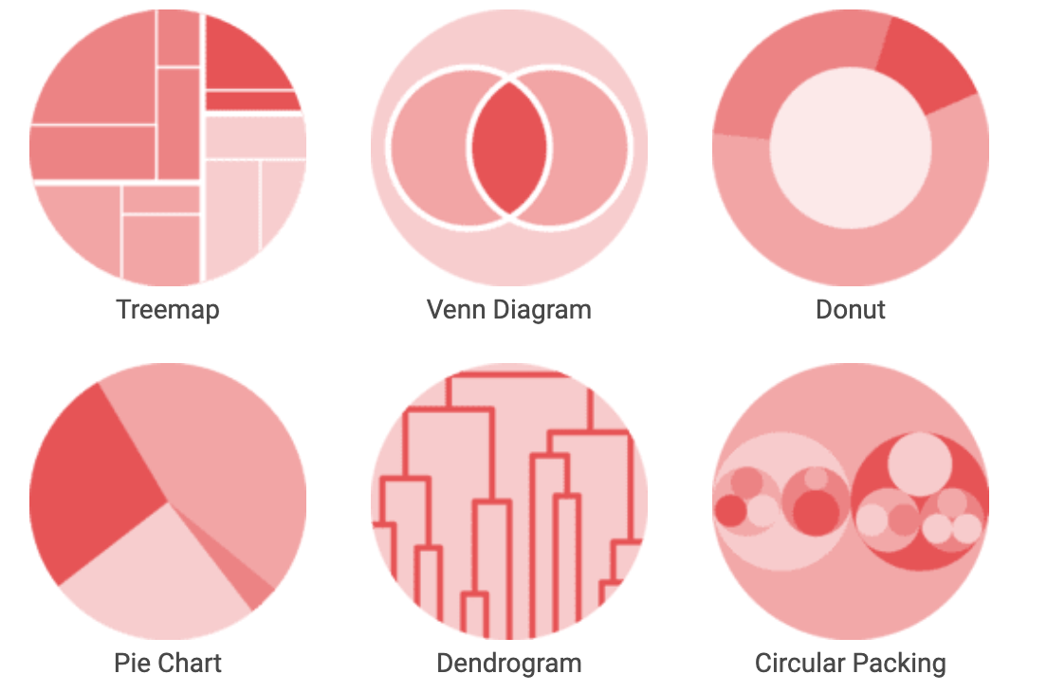
Part of Whole
https://python-graph-gallery.com/

Slide 12
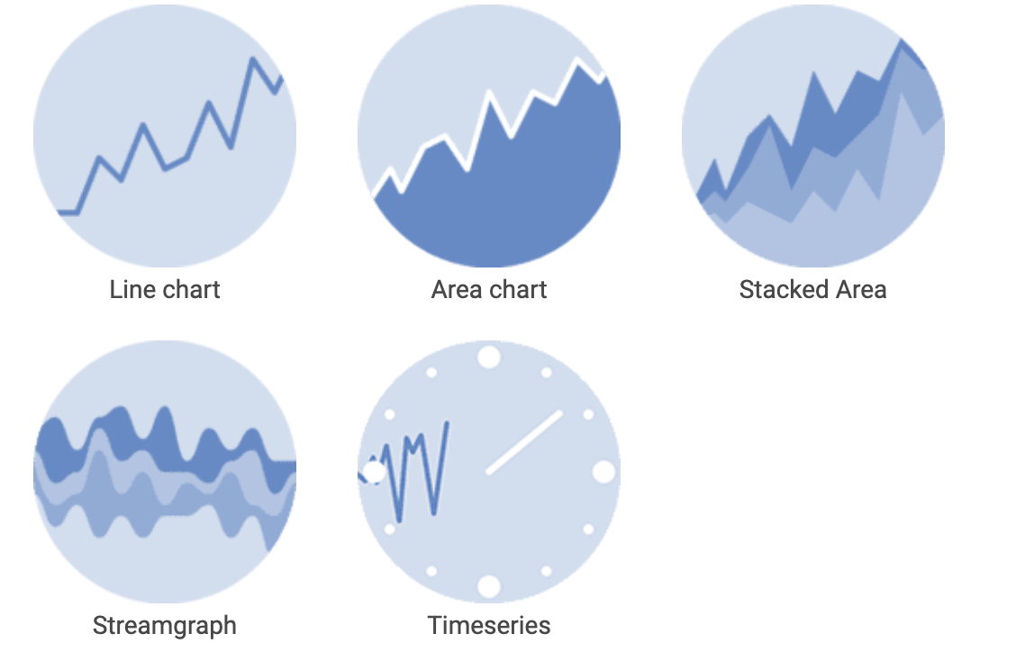
Evolution
https://python-graph-gallery.com/

Slide 13
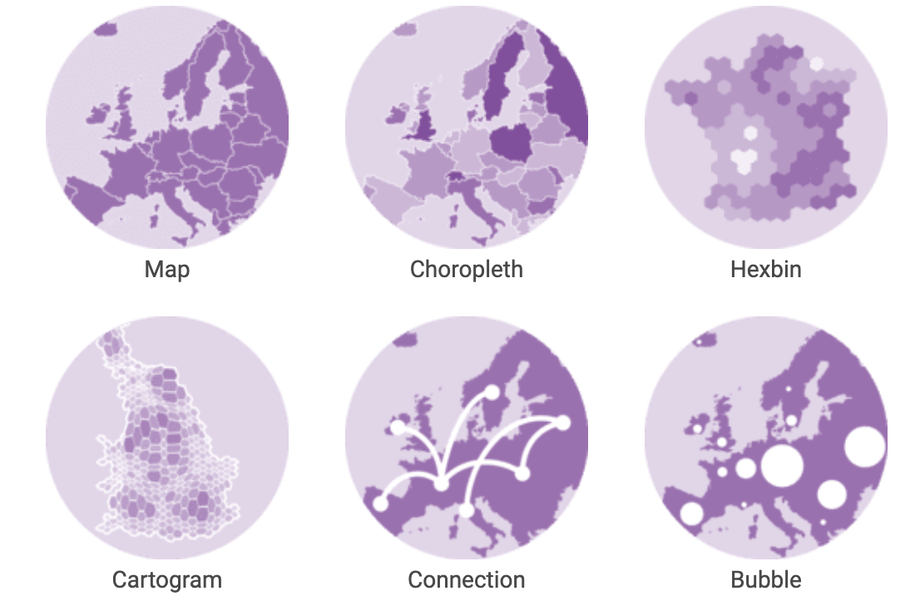
Map
https://python-graph-gallery.com/

Slide 14
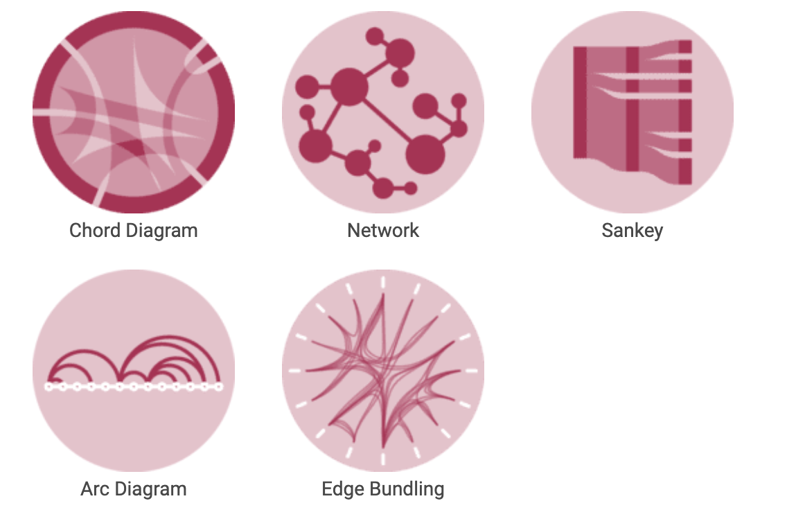
Flow
https://python-graph-gallery.com/

Slide 15
Python Plotting Libraries
Matplotlib (some interactivity)
Pandas (basic)
Seaborn
Ggplot (Copy of famous ‘R’ package)
Plotly (interactive)
Bokeh (Interactive)
Notes:
Seaborn builds on Matplotlib and Pandas
It is for statistical graphics
See https://seaborn.pydata.org/introduction.html for examples.

Slide 16
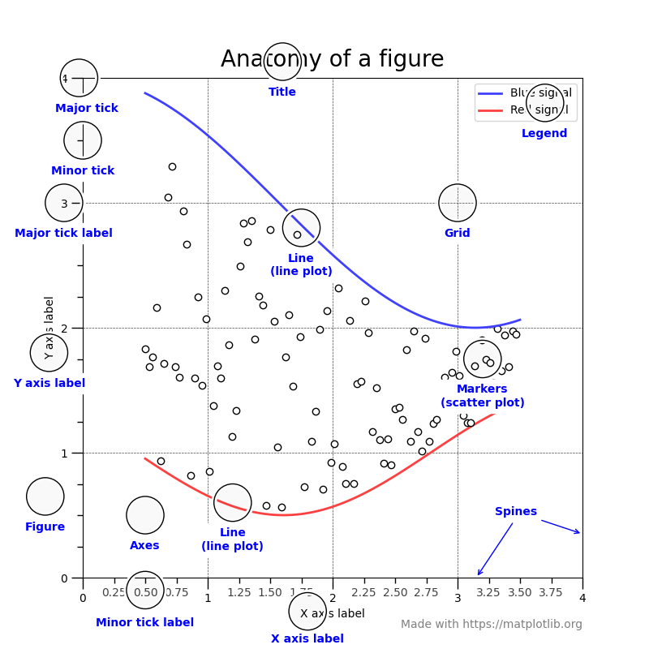
https://matplotlib.org/3.5.0/gallery/showcase/anatomy.html

Slide 17
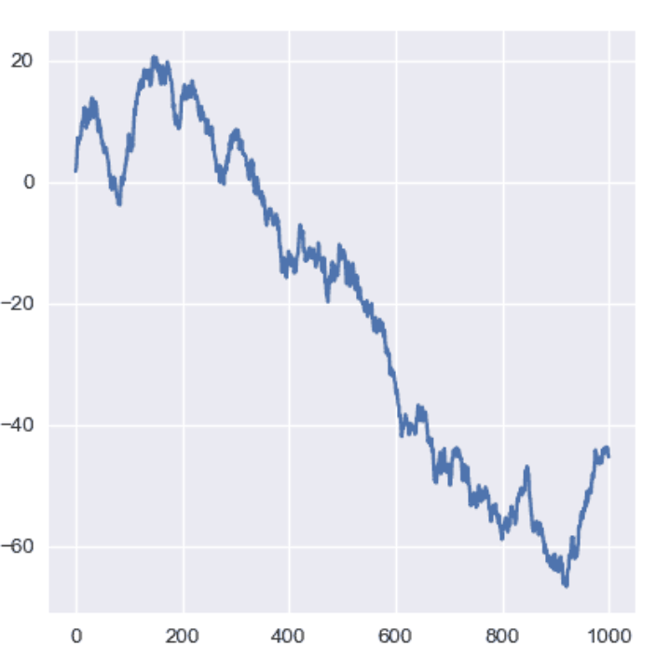
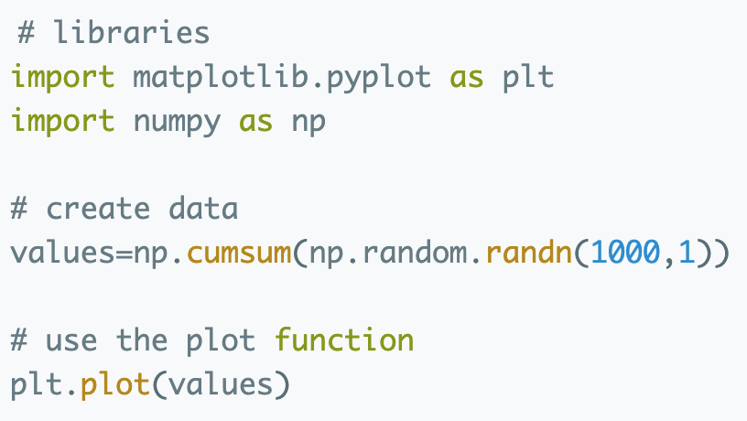
Python Graph Gallery
Plot + Code
https://python-graph-gallery.com/line-chart/

Slide 18
Python Dashboards
Dash
Anvil
Atoti
Streamlit
Panel
Explainer Dashboard

Slide 19
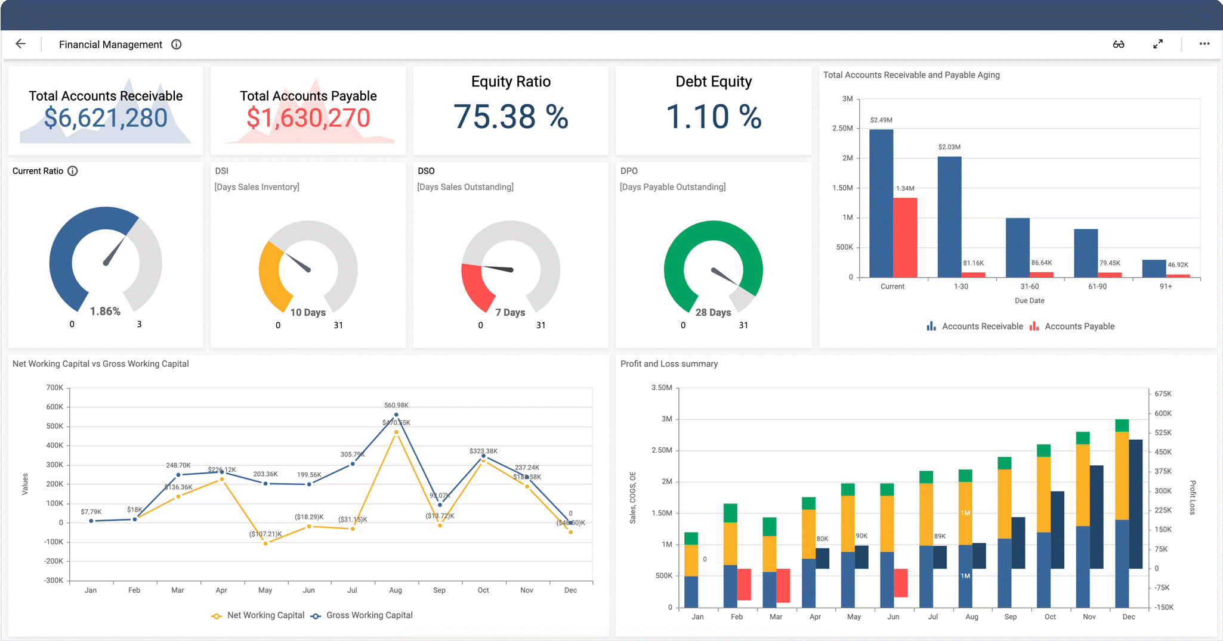
Dashboards

Slide 20
How to Guide
Find the data you want
What story do you want to tell
Pick from the Python Graph Galley
Revisit Python lessons
How to get data (upload, wget, etc)
Google Packages
Implement in notebook (or script)

Slide 21
Can you?
Describe Visualisation
Identify the Common Roles
Use roles to select graph
List common Python plotting packages
Develop a visualisation strategy

